Slide 1
Title IV Reconciliation
Session 16
Barbara Davis| Nov. 2012
U.S. Department of Education
2012 Fall Conference

Slide 2
Agenda
Reconciliation basics
What to expect from FSA
How funds are initiated, increased, decreased, deadlines, etc.
Tips for internal reconciliation
COD and G5 website funding screens
Selected COD reports
Review of changes
What’s ahead?

Slide 3
Reconciliation Basics
General definition - Reconcile: to bring into agreement or harmony; make compatible or consistent
FSA definition - The process by which Title IV aid (grants, loans, and campus-based aid) recorded on the Department of Education systems is reviewed and compared with a school’s internal records
A school must
Identify and resolve discrepancies
Document reasons for any ending cash balances

Slide 4
Reconciliation Basics, continued
Internal Reconciliation
Between business/bursar/comptroller office records and financial aid system origination and disbursement records
Disbursement definition:
34 CFR 668.164(a) “…an institution makes a disbursement of title IV, HEA program funds on the date that the institution credits a student’s account at the institution or pays a student or parent directly with (i) funds received from the Secretary;…(iii) institutional funds used in advance of receiving title IV, HEA program funds.”

Slide 5
Reconciliation Basics, continued
Internal Reconciliation
Ensure that
What is posted to student accounts (i.e. amount and date) matches exactly the data in the school’s financial aid software
Net Drawdowns (ND) = Net accepted and posted disbursements (NAPD)
Cash is not held beyond cash management requirements
Internal cash transactions match school bank statements

Slide 6
Reconciliation Basics, continued
External Reconciliation
Disbursement transactions
Internal school disbursement records (both business office and financial aid office) match exactly to disbursement records in FSA systems - COD and FISAP
Cash transactions
Drawdowns, drawdown adjustments, and refunds of cash transactions in school internal records match exactly with transactions in COD/FISAP and G5

Slide 7
Reconciliation Basics, continued
Monthly reconciliation REQUIRED for Direct Loans (recommended for all programs)
FSA Handbook 2012-13 Volume 4-10
“A school must submit Federal Pell Grant, TEACH Grant, and Direct Loan disbursement records no later than 30 days after making a disbursement or becoming aware of the need to adjust a student’s disbursement.”
All Title IV Aid 30 day disbursement/adjustment reporting requirement published annually in the Federal Register
http://ifap.ed.gov/fregisters/FR062912AppReportRecord1112.html

Slide 8
Reconciliation Basics, continued
Regulatory requirements
Perkins- 34 CFR 674.19 (d) (1)
FWS- 34 CFR 675.19 (b)(2)(iv)
SEOG- 34 CFR 676.19 (b)(2)
Direct Loan- 34 CFR 685.102 (b)
Cash Management Regulations
34 CFR 668.161-166

Slide 9
What to Expect from FSA
Initial Authorizations
Funding Increases
Funding Decreases
Tools to assist with reconciliation
Close out deadlines

Slide 10
What to Expect - Initial Authorizations
Campus-Based
Initial allocations based on prior year FISAP reporting announced Spring of each year
PELL
No initial authorization - funding is increased by reporting, and having accepted by COD, actual disbursement records
Teach
No initial authorization - funding is increased by reporting, and having accepted by COD, actual disbursement records
Direct Loan
Initial authorization for Advance funded schools available in Spring

Slide 11
What to Expect - Funding Increases
Campus-Based - Supplemental Campus-based awards if available announced in late summer
Pell and Teach - increases made available only by reporting (and having accepted) actual disbursement records. Can report up to seven days in advance of the actual disbursement date
Direct Loans (advance funded schools only)
Additional CFL increase in November
Submit actual disbursement records up to seven days in advance of actual disbursement date. Disbursements that exceed CFL will result in an automatic increase
Contact COD customer service to request an increase in CFL

Slide 12
What to Expect - Funding decreases
Campus-Based
Authorizations in G5 reduced to level of expenditures reported on FISAP
2011/2012 award year scheduled for March 2013
Pell
Authorizations in G5 reduced to Net Drawdown (ND)*
Pell 2009-2010 was reduced March 2012
Verification W Reduction
April, August and October 2012 for Pell 2011-2012
Direct Loans
Authorizations in G5 reduced to Net Draws (ND)
Immediately following the close of the award year - for example 2010/2011 DL was reduced August 2012
*Not scheduled to run for Pell 2010-2011 at this time

Slide 13
What to Expect - Funding Decreases
Why are these decreases important to reconciliation?
The available balances in G5 for Campus-Based programs may not match expenditures reported on FISAP
The available balances in G5 for Grants and Direct Loans may not match the disbursements reported in COD
To properly reconcile YOU MUST ensure that net draws in COD/G5 equal net disbursements/expenditures in COD/FISAP

Slide 14
What to Expect - Deadlines
CLOSE OUT/ RECONCILIATION DEADLINES
*(system processing deadlines may impact the actual date final disbursements are accepted)
Campus-Based - FISAP filing deadline September 30th
http://ifap.ed.gov/eannouncements/082712ReminderOctober12012Deadline4SubmittingFISAP.html
Pell - September 30th of the award year
http://ifap.ed.gov/eannouncements/090612IraqAfghanistanServiceGrantPell1112AYDeadline.html
Teach - September 30th of the award year
http://ifap.ed.gov/eannouncements/090612TEACHCloseout1112Part2of2.html
Direct Loan - July 31st of the year following the award year
The close out deadline for Direct Loans 2011-2012 will be July 31, 2013
http://ifap.ed.gov/eannouncements/070312Additional1011DLPCloseoutInfro.html

Slide 15
What to Expect - Deadlines
Remember - A school must follow all existing regulations for drawing funds and reporting disbursements and disbursement adjustments timely.
Most schools should be able to reconcile and complete processing well before close out deadlines.
You must monitor IFAP closely for announcements related to funding and reconciliation deadlines for all Title IV programs.

Slide 16
What to Expect - Tools
Pell
Electronic Statement of Account - cash (SAIG)
Pending disbursement list (SAIG and Web)
Reconciliation Report - summary level disbursement totals (SAIG)
Year to Date (YTD) file - detail disbursement data (SAIG)

Slide 17
What to Expect - Tools
Direct Loans and Teach
Pending disbursement list (SAIG and Web)
Actual disbursement list (SAIG and Web)
School Account Statement (SAS) - (SAIG)
New for 2013: SAS Disbursement Detail on Demand (SAIG)
Direct Loan Tools software - for DL SAS reconciliation assistance
Pell, Direct Loan, and Teach
COD school monitoring report (SAIG and Web)
COD Action Queue (Web)
COD reconciliation specialists

Slide 18
Tips for Internal Reconciliation
Daily/weekly check in between Business Office and Financial Aid Office
Do disbursements reported match disbursements posted?
Do draws and returns of funds match disbursements?
Does the school banking information match G5 data?
Return funds appropriately to the correct program and year
Electronically
Adjustments only to correct errors
Time frame for returning unclaimed funds (stale dated checks) no later than 240 days from the date check issued
34 CFR 668.164(h)

Slide 19
Returning Funds
Return of funds through G5 should be made electronically
Set up a bank account through G5 for refunds
G5 hotline 888-336-8930
If funds are being returned through G5 for regulatory reasons schools MUST send downward disbursement adjustments for Grant/Direct Loan Programs*
Reminder! If returning funds from an audit or program review liability
Follow directions per the Final Audit or Program Review Determination letter
Reminder! DL 120 day rule does not apply when returning funds due to regulatory/statutory requirements
*For Grant programs, disbursement changes cannot be submitted
after funding for the award year has been canceled.

Slide 20
Returning Funds
If exceptional circumstances require that you must return FSA funds via paper check:
Note that there are TWO DIFFERENT addresses, one for Grants and one for Direct Loans
Please see sidebar instructions 2012-13 FSA Handbook Volume IV page 4-68
Adjustments to Campus-Based Funds
Amend FISAP
Return funds through G5
2012-13 FSA Handbook Volume IV page 4-71
NO adjusting of funds between awards on G5
http://ifap.ed.gov/eannouncements/062812G5SystemChangeCampusBaseProgAwards.html

Slide 21
Reconciliation Tips
Pay attention to IFAP announcements and COD updates regarding funding reductions
Once you have confirmed that Business Office and Financial Aid Office records match (internal reconciliation) then…
Begin the regular and at least monthly external reconciliation with COD and G5
Daily/weekly monitor edit code rejects
Rejected disbursements: DL-unsubstantiated cash, Pell/Teach - no funding
COD and G5 web screens
COD and G5 reports

Slide 22
Edit Code Rejects/Warnings
Warnings are there to alert you of a potential problem
Edit code rejects - do not build on the COD system
Monitor your batch import results or view rejects by batch on the COD website
Set aside time to resolve edit code rejects daily/weekly
Rejected Direct Loan records can lead to unsubstantiated cash for advance funded schools
Rejected Pell Grant and Teach records will not increase available funds in G5

Slide 23
Batch Menu- Reject Monitoring

Slide 24
COD and G5 Web Screens
COD
School menu/School Summary Information
School menu/School funding Information
School menu/Request Post deadline/ Extended Processing
School menu/Correspondence
Batch menu/Grant data request
Batch menu/action queue
G5
External award activity report

Slide 25
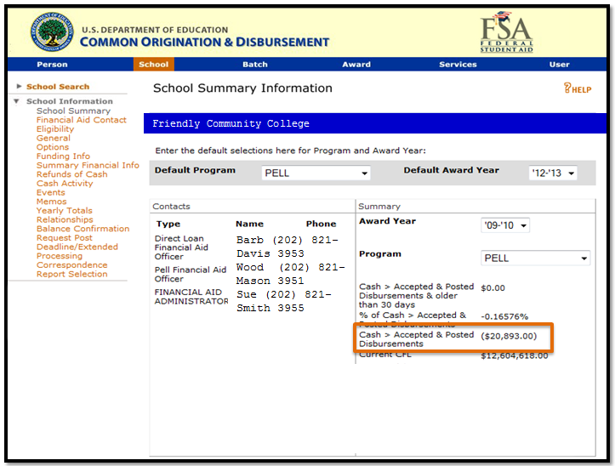
COD Web Screens - School Summary
Keep contacts current
First place to check
Program and award
Year balances

Slide 26
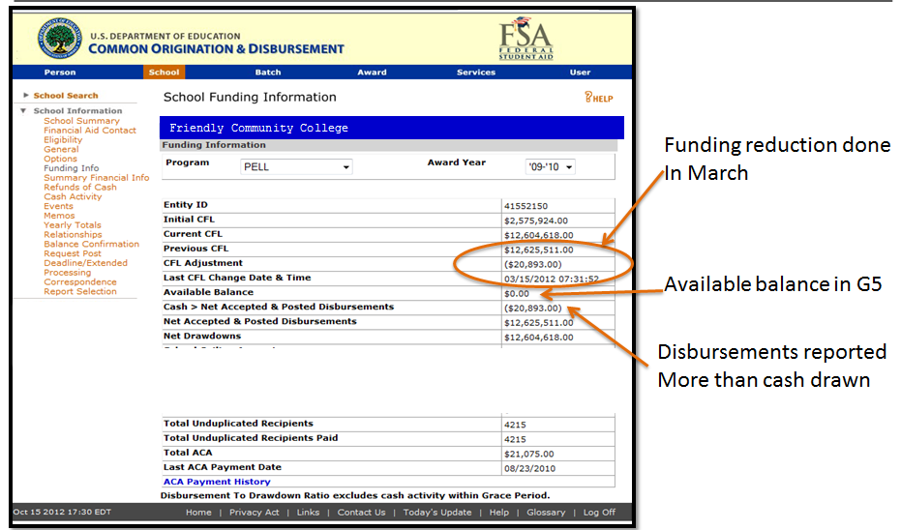
COD Web Screens - Funding Info

Slide 27
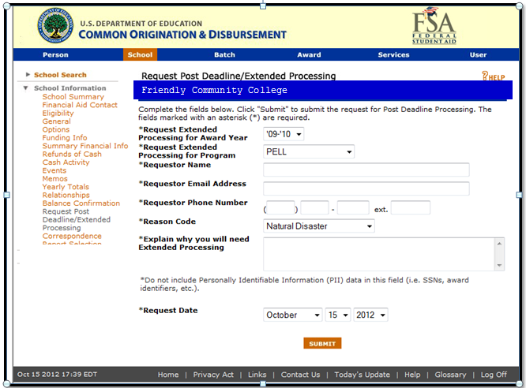
COD Web Screens - Extended/Post Deadline Processing

Slide 28
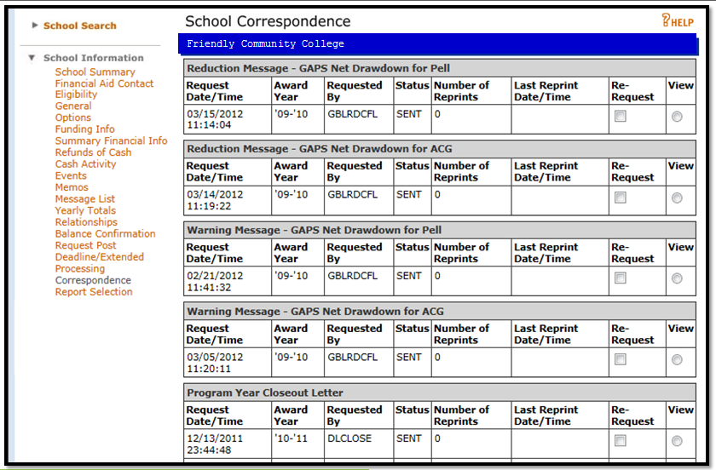
COD Web Screens - Correspondence

Slide 29
COD Web Screens - Action Queue
Search forward or backward
Search by award year
Can be used as both a
reconciliation tool and
as an adhoc pending
disbursement
list tool.
60784345

Slide 31
G5 Website: G5.gov
Read only access is available
for financial aid administrators.
Use G5 to draw and refund cash.
Monitor draws and refunds.
Does NOT contain disbursement
level data.

Slide 32
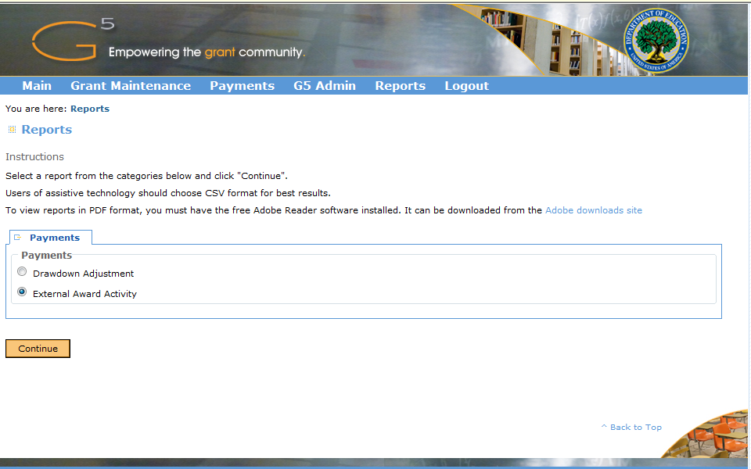
G5 Reports

Slide 33
G5 Award Numbers
G5 Award Numbers are program
and award year specific.
The examples below reflect the 2012-2013 award year, by program
Program | G5 Award Number | Award Year
Direct Loan | P268K13#### | Trailing Year
TEACH | P379T13#### | Trailing Year
Pell | P063P12#### | Leading Year
IASG | P408A12#### | Leading Year
Campus Based | FWS: P033A12#### SEOG: P007A12#### | Leading Year

Slide 35
G5 web-External Award History Report
Pell 2009-2010
Note the amount
of activity.
This award year was
supposed to be closed
September 30, 2010.

Slide 36
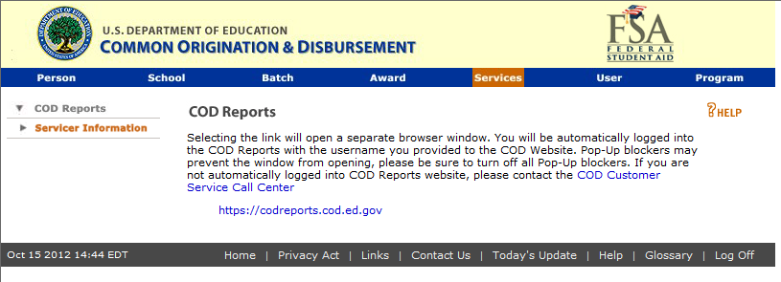
COD Reports - School Monitoring
School monitoring report - available weekly through SAIG and on the COD website - newsbox
Will display in both the Pell and Direct Loan newsboxes
Number of Pell POPS
Unsubstantiated cash (positive values only) by program and award year
% of disbursement records reported timely

Slide 37
School Monitoring Report

Slide 38
Pell COD Reports

Slide 39
Pell COD Reports
Electronic Statement of Account - ESOA (SAIG)
Assist in monitoring Cash
Reconciliation report (SAIG)
Assist in monitoring summary level disbursement date
Year to date file - YTD (SAIG)
Assists in monitoring detail level disbursement
Multiple Reporting Record (MRR) (SAIG)
Can be requested proactively after originating to prevent POPs
Automatically sent when multiple schools report overlapping actual disbursement data
Pell POP report ( available both COD web and SAIG)
Resolve POPs before FSA reduces all disbursements to zero and reduces funding

Slide 40
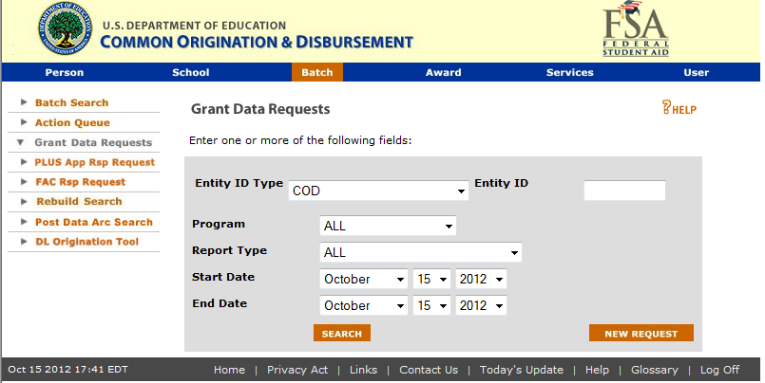
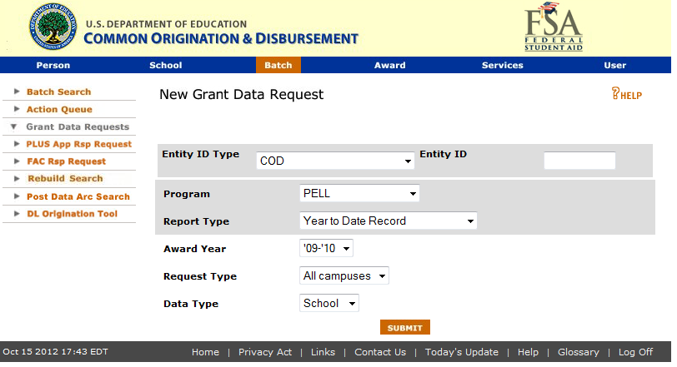
COD Web Screens - Grant Data Request

Slide 41
Direct Loan COD Reports
Pending disbursement list
Direct Loan Actual
disbursement list
School Account Statement

Slide 42
Direct Loan Newsbox
Note
modified
date

Slide 43
Direct Loan COD Reports
Pending Disbursement List (SAIG and COD web)
Can be used to identify pending disbursements that should be actual disbursements, or that should be reduced to $0
Consider using the Action Queue to run adhoc pending disbursement lists
Actual Disbursement List (SAIG and COD web)
Useful tool to monitor if actual accepted disbursements and amounts match what was posted to student accounts on a weekly basis
School Account Statement (SAS) (SAIG only - monthly)

Slide 44
Direct Loan School Account Statement (SAS)
Provides the Department’s official monthly Ending Cash Balance and detailed cash and disbursements (SAIG only)
Generated the first full weekend of the month and reflects data up to the end of the previous month (YTD or month to date depending on your settings)
You MUST reconcile monthly to the balances reflected on the SAS and must document that you have done so
Composed of 4 Sections
Cash summary
Cash detail
Disbursement Summary by loan type
Loan detail, loan level or detail disbursement activity level

Slide 45
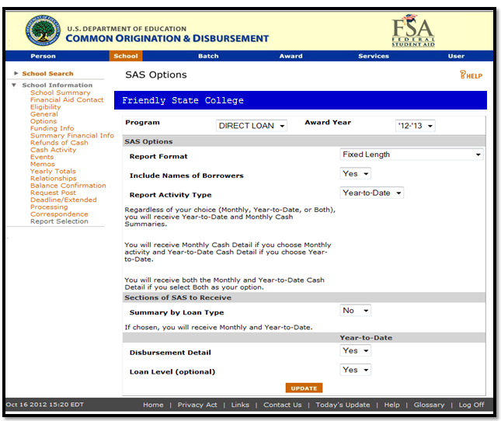
Setting Your SAS Options
Fixed Length YTD
works best with most
school software
YTD helpful for final end
of year reconciliation

Slide 46
Cash Summary
Contains both monthly and year to date cash (draws and refunds) and loan disbursement (disbursements and adjustments) SUMMARY level data
If the cash and disbursement summary totals match your school’s FAA and Business Office records then you are done and can document for that month
If the total’s don’t match due to timing differences with cash draws or refunds, or disbursements that have not yet posted in COD- Document and you are done.
If not, then move on to the cash detail or loan detail sections

Slide 47
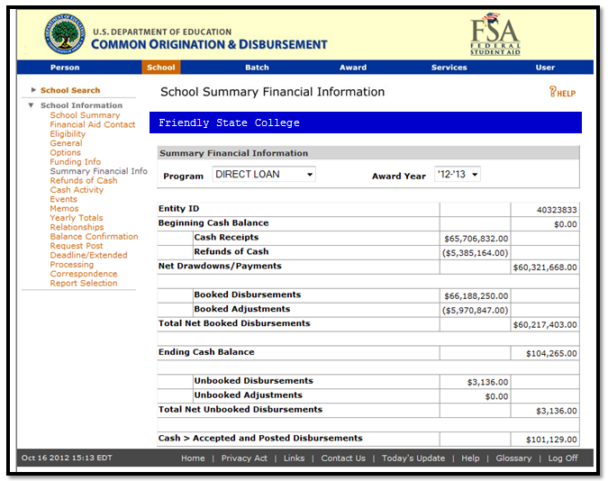
COD School Summary Financial Info
Mirrors the SAS cash
summary layout but
updates daily
Great way to monitor
your daily cash and
disbursement activity
at the summary level

Slide 48
SAS Detailed Reports
Use the Cash detail to ensure that cash and refunds post to the correct award year
Use the loan detail, either loan level or disbursement level, to ensure that what is accepted on COD matches exactly to what is reflected in your school data
Both disbursement dates and amounts reported in COD must match what was posted to student accounts
Direct Loan Tools
Can be used with all school software to compare the SAS to school records
Or can be used to print out or view the SAS reports
Download for free from www.fsadownload.ed.gov

Slide 49
Review of Recent Changes (related to reconciliation)
DL actual disbursement list
Direct Loan Interest rebate report
Pell Lifetime Eligibility Used Report
Pell Edit code warnings - 177 and 178
Lifetime percentage of Eligibility Used
CB- reminder no transfer of funds between accounts
http://ifap.ed.gov/eannouncements/062812G5SystemChangeCampusBaseProgAwards.html

Slide 50
What’s Ahead? 2013-14 Award Year
No Direct Loan initial funding authorization for HCM1 schools
HCM1 schools submit actual disbursement records up to seven days in advance of disbursement date in order to have funds available in G5
Same as Pell Grant and Teach Grant process
New look for Grant data and DL report requests
SAS Disbursement Detail on Demand
Available for both Direct Loans and Teach
Available with COD new award year release March 2013

Slide 51
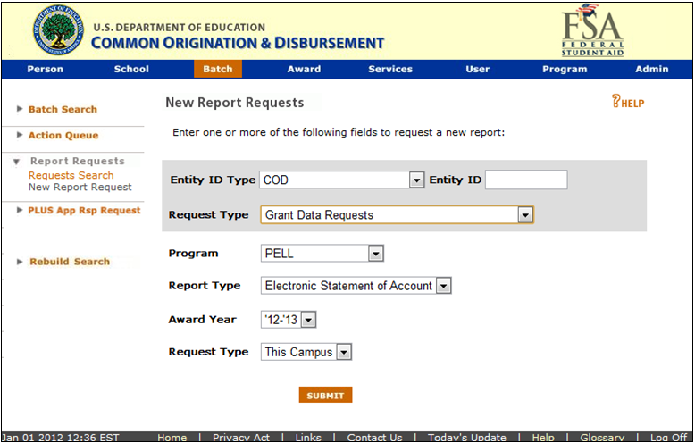
COD Web Grant Data Requests
v
v

Slide 52
SAS Disbursement Detail On Demand
Requested via COD website
Delivered via the SAIG Mailbox
File length and existing fields remain the same as the SAS Loan Detail, Disbursement Activity Level section
Start date added to fixed length filler layout and to delimited file layouts (needed for date range requests)

Slide 53
SAS Disbursement Detail On Demand
Year to Date (School can choose End Date)
Month to Date (School can choose End Date)
Date Range (School can choose Start and End Date)
All are Program and Award Year specific (data doesn’t include more than one award year)

Slide 54
SAS Disbursement Detail On Demand
Direct Loan
Comma Delimited – option of borrower names
Comma Delimited with Headers - option of borrower names
Pipe Delimited – option of borrower names
Fixed Length – No borrower names
Teach
Comma Delimited with Headers

Slide 55
SAS Disbursement Detail on Demand
Program | Format Option | Data | Message Class | Borrower Name Option
Direct Loan | Comma Delimited | Year to Date | DSYCyyOP | Yes
 |  | Month to Date | DSMCyyOP
 |  | Date Range | DSRCyyOP
 | Comma Delimited with Headers | Year to Date | DSYHyyOP | Yes
 |  | Month to Date | DSMHyyOP
 |  | Date Range | DSRHyyOP
 | Pipe Delimited | Year to Date | DSYPyyOP | Yes
 |  | Month to Date | DSMPyyOP
 |  | Date Range | DSRPyyOP
 | Fixed Length | Year to Date | DSYFyyOP | No
 |  | Month to Date | DSMFyyOP
 |  | Date Range | DSRFyyOP
Teach | Comma Delimited with Headers | Year to Date | TSOYyyOP | Student name already automatically included
 |  | Month to Date | TSOMyyOP
 |  | Date Range | TSORyyOP

Slide 56
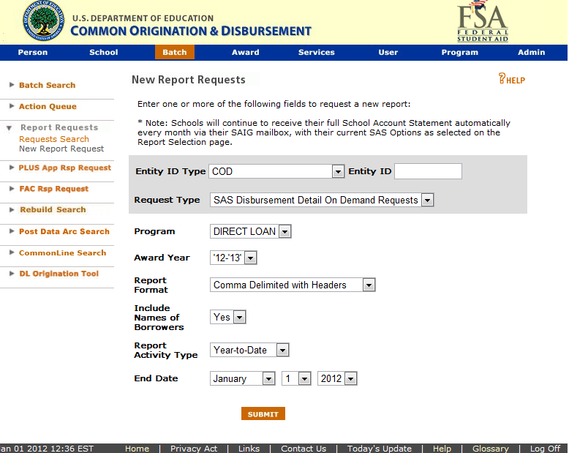
SAS Disbursement Detail on Demand
v
v

Slide 57
Reconciliation Resources
FSA Handbook - Volume 4
COD technical reference
Implementation guide, edit code rejects, reports, DL tools
Blue Book - updated version available soon
IFAP announcements - you must monitor IFAP to be considered administratively capable
Detailed recorded training materials available
COD reconciliation team - contact via the main school services number 800-848-0978 or 800-474-7268
Federal Loan School Support Team (FLSST)
dlops@ed.gov

Slide 58
QUESTIONS?
Barbara.davis@ed.gov
202-821-3953

